Slide 1


HOTEL BOOKINGS
CANCELLATIONS PREDICTION
Final Project Purwadhika
Iota Integer Team
Ferdi Endinanda Fuaadi
James Nathanael Nainggolan
Notes:
Good evening everyone, we are from Iota Integer team and would like to present our final project at Purwadhika about hotel bookings cancellations prediction.

Slide 2
OUTLINE
01
02
03
04
05
Iota Integer Team
DATA
PREPROCESSING
MACHINE
LEARNING
RECOMMENDATION
&
CONCLUSION
INTRODUCTION
SOLUTION
About us, workflow,
problem and goal
Data understanding,
Data cleaning,
and EDA
Feature selection,
Feature engineering,
Modelling
The results
Insights and what can we provide
Notes:
-First of all, we would like to present our findings starting with introduction about our team, workflow, the problem and goal
-Next how we process the data, understanding, cleaned and analyzed it
-Continued by the machine learning process, selecting relevant feature, engineering certain features and then modelling
-Then the results to support and elaborate findings
-Finally, concluding the overall result and provide recommendations for the business

Slide 3
01
INTRODUCTION
Iota Integer Team

Slide 4


OUR TEAM
Iota Integer Team
Ferdi Endinanda
James Nainggolan
Project Geological Engineer
ferdiendinanda@gmail.com
https://github.com/ferdiendinanda
Aircraft Maintenance Engineer
jmsxngl@gmail.com
https://github.com/jmsxngl
Notes:
We would like to introduce ourselves starting from myself, My name is … , and I am accompanied with my teammate …

Slide 5






WORKFLOW
Iota Integer Team
PROBLEM
& GOAL
DATA UNDERSTANDING
DATA CLEANING
EDA
RESULT
MODELING
FEATURE ENGINEERING
FEATURE
SELECTION
Notes:
Our workflow in this project starts with stating the problem and setting our goal, understanding the data we was provided, cleaning data, analyze, selecting, data engineering, modelling and produce results.

Slide 6

THE PROBLEM
THE GOAL
Iota Integer Team
In this project we position ourselves as Data Scientist consulting for a client which is a hotel management that is facing a problem:
Experiencing an increase in booking cancellations especially in high peak seasons and they would like to be able to prioritize among those who the hotel thinks are likely to be cancelling.
We are assigned to predict booking cancellations based on customer behavior to distinct them between the ones that are not canceling.
Notes:
So, we’ll start with identifying the problem
Our client has a problem experiencing an increase in booking cancellations especially in high peak season because of certain customers cancelling their booking. They would like to know who to prioritize among those whom the hotel thinks are likely to be cancelling.
To solve the problem, we want to predict these customers that cancels based on the customer historical booking data.

Slide 7
02
DATA PREPROCESSING
Iota Integer Team

Slide 8

DATA UNDERSTANDING
Iota Integer Team
The data is taken from https://www.kaggle.com/datasets/jessemostipak/hotel-booking-demand
The data contains hotel bookings due to arrive between 2015 and 2017 and most of this data is taken in Portugal
Booking data shape is 119390 rows and 32 features
Each record of data represents information related to ordering transactions that occur. Unbalanced dataset (is_canceled)
Useful Features :
is_repeated_guest : Value indicating if the booking name was from a repeated guest (1) or not (0)
previous_cancellations : Number of previous bookings that were cancelled by the customer prior to the current booking
assigned_room_type : Code for the type of room assigned to the booking.Code is presented instead of designation for anonymity reasons
deposit_type : Indication on if the customer made a deposit to guarantee the booking. This variable can assume three categories No
customer_type : Type of booking, assuming one of four categories Transient - Transient-Party - Contract - Group
adr : Average Daily Rate as defined by dividing the sum of all lodging transactions by the total number of staying nights
required_car_parking_spaces : Number of car parking spaces required by the customer
total_of_special_requests : Number of special requests made by the customer (e.g. twin bed or high floor)
hotel : H1 (Resort Hotel) or H2 (City Hotel)
is_canceled : Value indicating if the booking was canceled (1) or not (0)
lead_time : Number of days that elapsed between the entering date of the booking into the PMS and the arrival date
adults : Number of adults
children : Number of children
babies : Number of babies
meal : Type of meal booked. Categories are presented in standard hospitality meal package Undefined/SC – no meal
market_segment : Market segment designation. In categories, the term “TA” means “Travel Agents” and “TO” means “Tour Operators”
distribution_channel : Booking distribution channel. The term “TA” means “Travel Agents” and “TO” means “Tour Operators”
booking_changes : Number of changes made to the booking from the moment the booking was entered on the PMS until the moment of check-in or out
Notes:
The data that was taken from kaggle which is a customer historical bookings between 2015-2017 having 119390 row and 32 columns as the features. The description is provided here and we will give time to view.
What we probably want to highlight is on the bottom right on market segment and distribution channel which both have TA/TO, market segment here means how customers set their booking, while distribution channel is where was the hotel advertised and seen by customer.
And also we’dlike to highlight that customer type is how many people that comes with the booking, different to group in market segment which is multiple rooms customer booked all at once.

Slide 9
DATA CLEANING
01
02
03
Iota Integer Team
Check NaN values → The 'company' feature has 94% NaN values and considered to be dropped, null in children filled with 0.
Reformat reservation status date to date and time format, also the arrival date into a new date and time feature.
Spotting undefined, negatives, outliers, and irrational values and changing them into mean or mode of the data. The features are meals, lead time, adr, market segment, distribution channel,
Notes:
Next we cleaned the data that was irrational such as NaN values, reformatting between categorical/numeric to certain types like date and time, and spotting undefined which is not detected by the null search method.

Slide 10
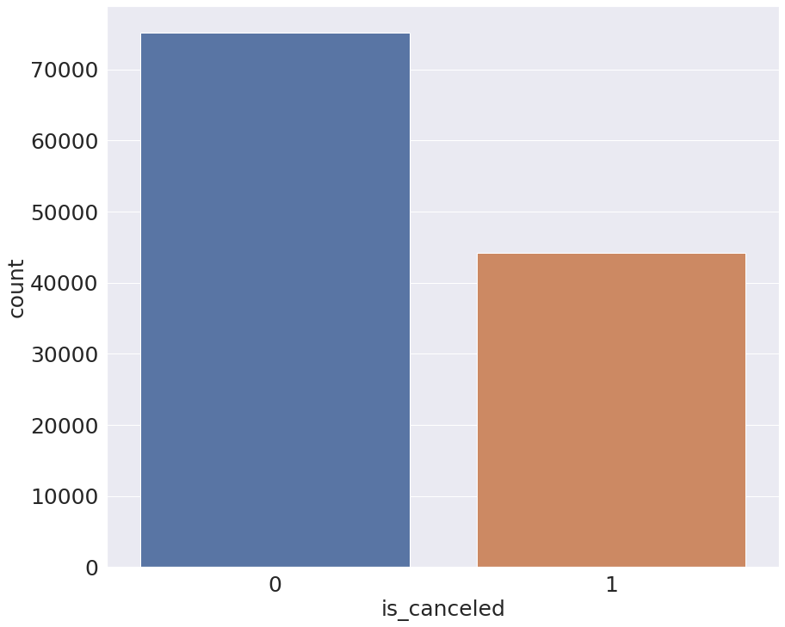
EXPLORATORY DATA ANALYSIS
Iota Integer Team
Data Imbalance
63%
The total of not cancel (0)
is much more than cancel (1).
This indicates data is imbalanced
37%
Notes:
Getting into data analysis from the data,
First of all, 37% of the customer still cancels their bookings. In another way our client has lost 44,174 in total of customers in that 2 years of operation.
We set our analysis and prediction focusing on the customers that cancels and observe their characteristic so that we can press this number.
We have put the features which we think is important and they are provided in a couple of graph set to group them all together in the next couple of slide.

Slide 11
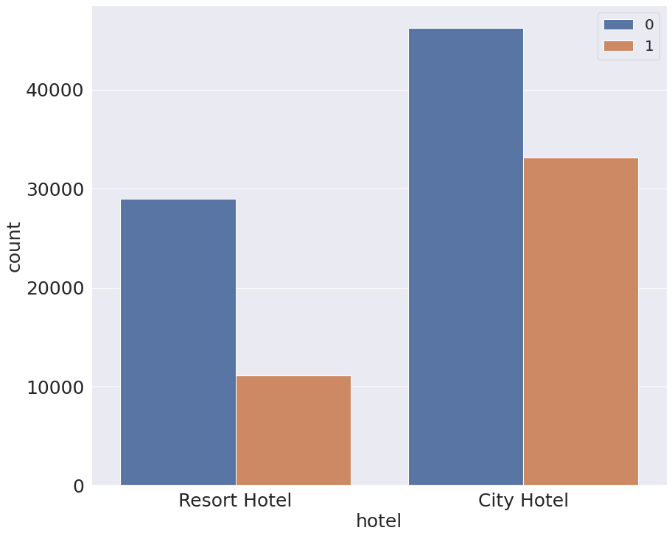
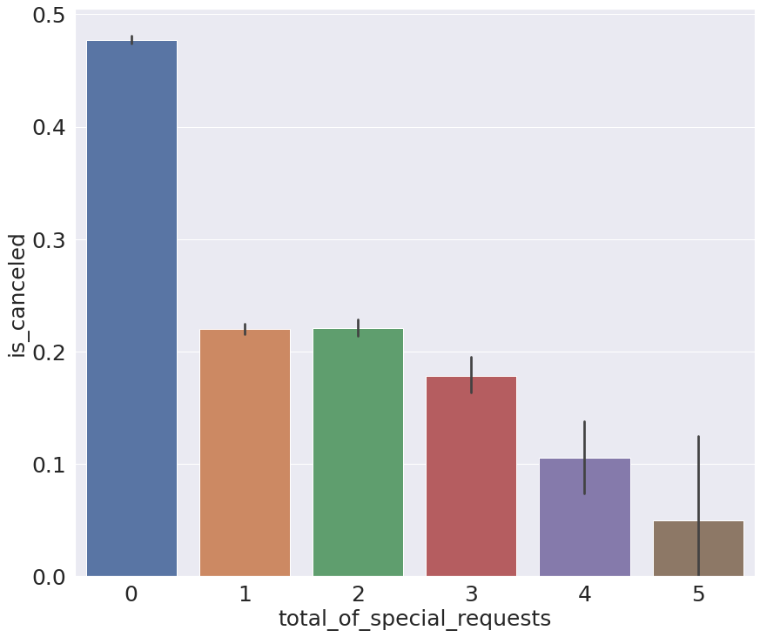
EXPLORATORY DATA ANALYSIS
Iota Integer Team
Hotel
Hotel
Canceled mostly happened in city hotel rather than resort hotel giving insight people tend to cancel while it is at the city that has many option of places to stay.
Special Request
Less special requests is much more likely to cancel than high requests. This is because the customer that has special request is more likely to have a well planned trip rather than customers without special requests.
Notes:
Now we should look at the hotel graph set
Looking at city hotels having a larger portion of customer bookings puts them at a much more higher risk with the ratio of cancellation between the two hotel type is 1:3 losing most of the customers.
Customers that does not have any special requests recorded having a 0.3 higher chance than those with special requests in their bookings as customers just want to lock in availability but still keeps their flexibility for their change of plans in contrast with customers that has a well planned visit.
But we have to see other more features to get a broader point of view

Slide 12
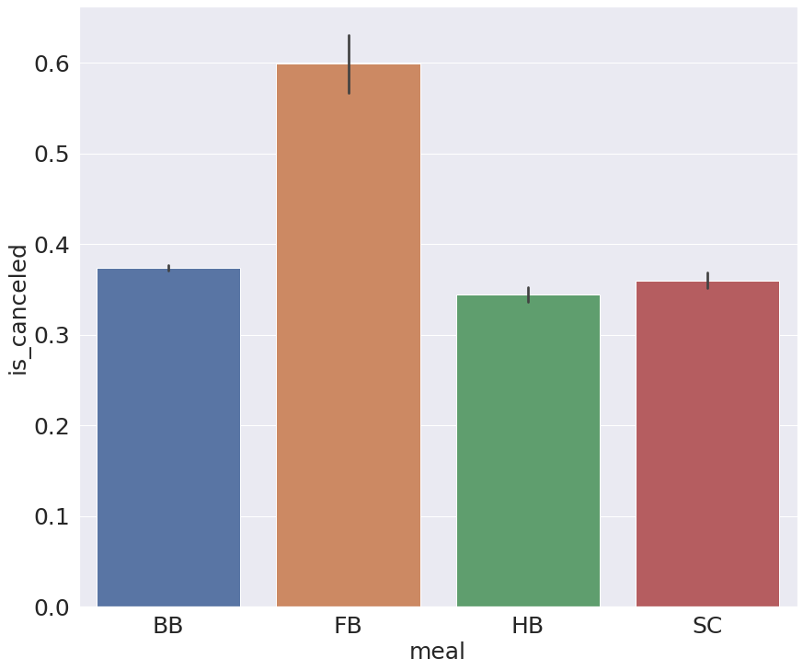
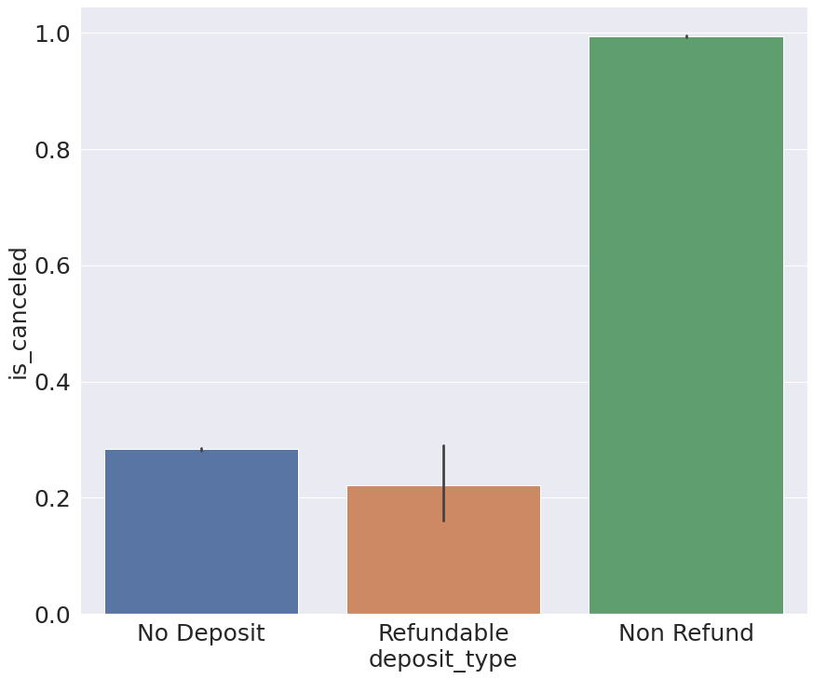
EXPLORATORY DATA ANALYSIS
Iota Integer Team
Hotel
Meal
People with meal Full Breakfast tends to cancel than other types of meal order. Perhaps this is related to additional price which is more expensive than other type of meal.
Deposit Type
Non-Refund is likely to cancel all the time which is quite unusual. Usually non-refundable types of booking are the ones that are made very close to arrival date, impulsive bookings, but looking at the data the time customer made the booking and arrive to the hotel (lead_time) is quite long, perhaps there is another reason. Perhaps the terms from the hotel with non-refundable option made customers uncomfortable/confusing.
Notes:
Customers that books full breakfast meals has a 0.2 higher chance of cancellation than other type of meal packages as the booking was made probably in default choice by the customer, similar with the previous they are only locking availability realizing later the expense that they had to pay was more expensive than other option.
Non refundable bookings has a 0.7 higher chance of cancellations than other types of booking which shows non-refund as an uncomfortable choice for most customers.

Slide 13
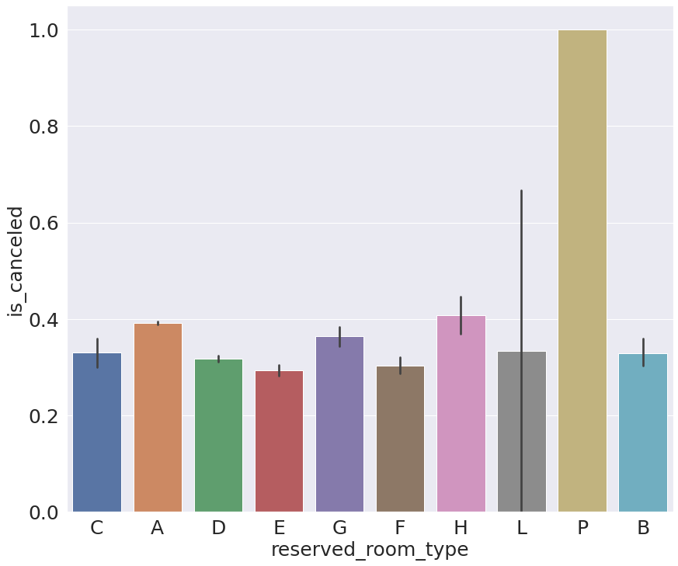
EXPLORATORY DATA ANALYSIS
Iota Integer Team
Hotel
Room Type
Most cancelation was made when the booking was reserved room type P. This is not very clear of why cancelation took place on these types of room, perhaps additional detail on hotel description of the room would give an answer of why these types of room are always being canceled. Probably the room type has bad review or the specs is not what customer hoped for.
Notes:
From the room type, cancellation has a 0.6 higher chance of cancellation for the P type when reserved then with P and L type when they are assigned perhaps due to the quality of those rooms, their specification, position of window view etc. The details in the assumption need to be investigated further with additional data from the hotel.

Slide 14
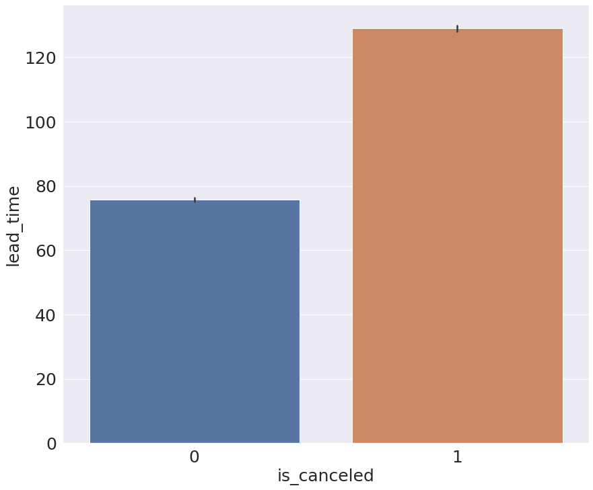
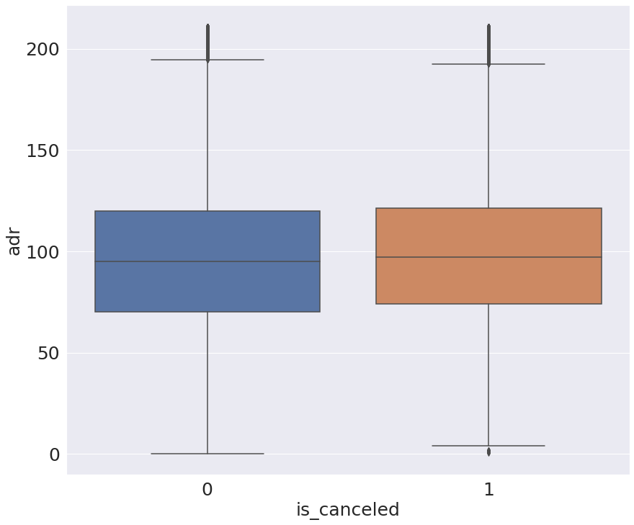
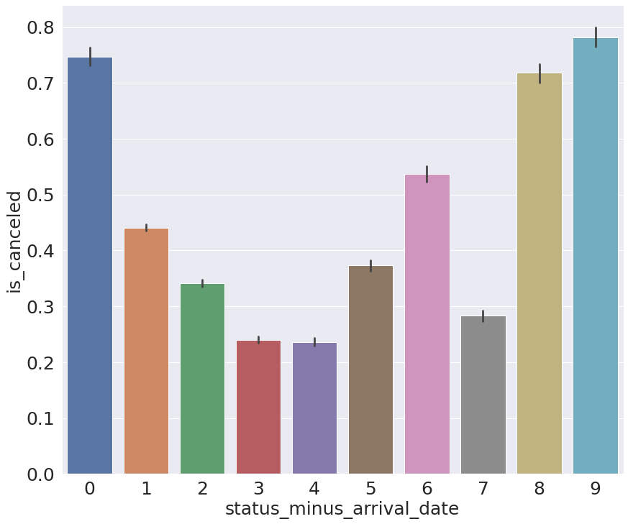
EXPLORATORY DATA ANALYSIS
Iota Integer Team
Time
Lead Time
When the booking was made very far in advance, people tend to cancel rather then keeping it because the costumer plans is more likely to change the longer it gets.
ADR
Both canceled and not canceled has the same price range around 60-120 USD. But we can still see cancelation happens at slightly more expensive rates hotels.
Status minus Arrival Date
Customers tend to cancel close to the arrival date (0 days) due to sudden events/no show or a couple days before (9 days prior) due to change of plans.
Notes:
From time context graph set
We can see that the longer of lead time it also has a higher cancellation tendency which shows customers like this still have a long way to go to make changes to their plans and cancels their booking.
The average daily rate of hotels between cancellations and not cancelled is quite similar but we can slightly see cancellation happens mostly with ADR reaching to 100 USD in their price which perhaps they found a better deal below this nominal.
Cancelling customers change their booking mostly 0 days due to sudden events and had to cancel/no show and around a week before with a higher chance around 0.5 compared to other amount of days.

Slide 15
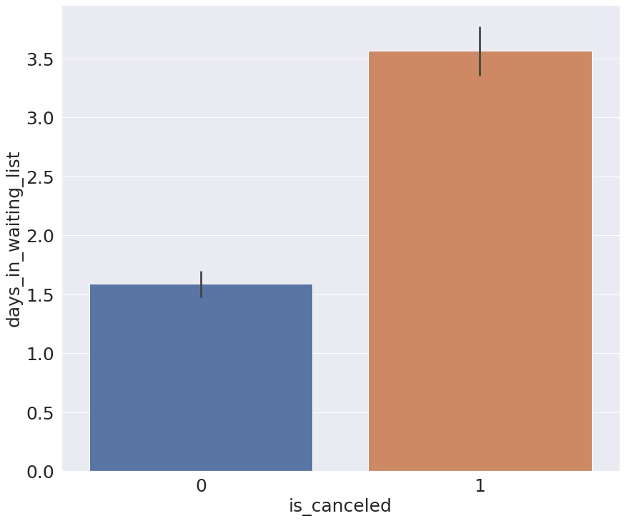
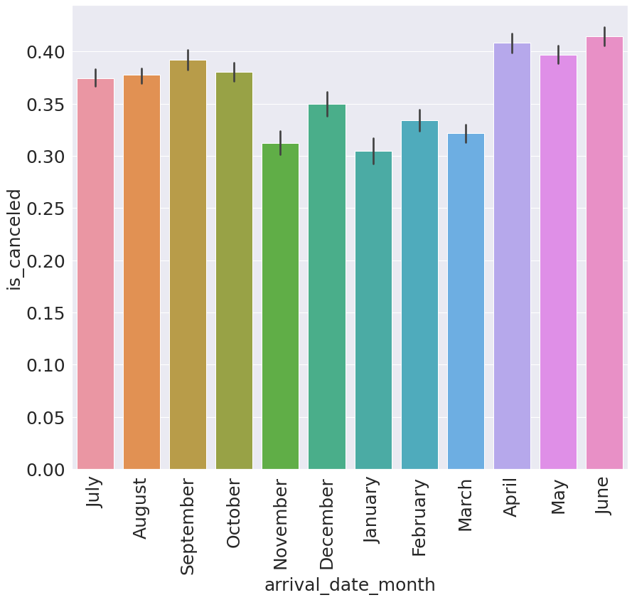
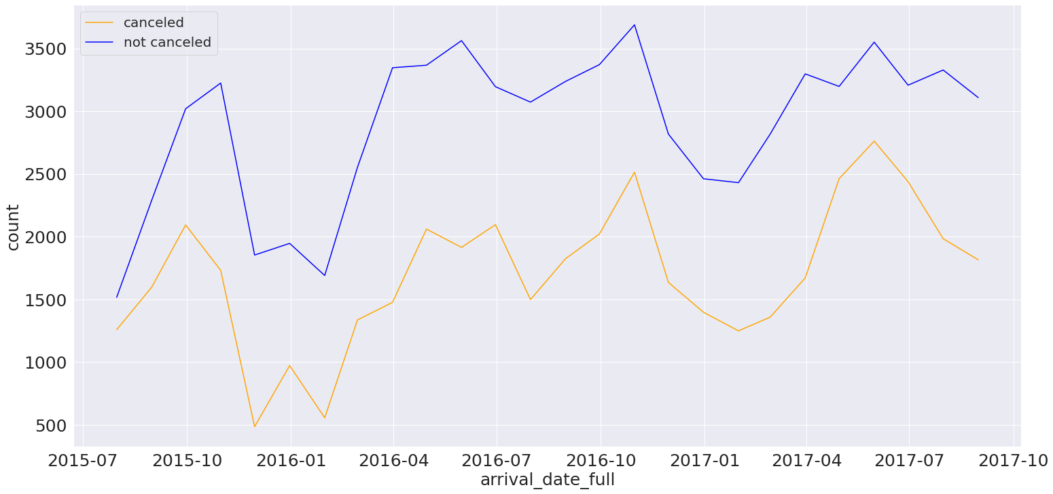
EXPLORATORY DATA ANALYSIS
Iota Integer Team
Time
Days in Waiting List
This makes sense as customers do not like to be in waiting list for their booking even just for a day, they tend to cancel with longer wait times because unsecured
bookings is very risky for their trip.
Month Arrival Date
We can see in the graph in months that is holiday season is more likely to be canceled, this is probably due to the much more variety of customers that books the hotel such as families or groups of people that are on a holiday which can have change of plans, while in non vacation season bookings are probably made by employees for business trips that is a much more fixed booking.
Arrival Date
From the complete set 2015-2017 data of booking arrival dates, it shows that bookings are much more made for seasonal months which are in the middle and at the end of the year. These peak seasons are the important times to predict cancelation especially in this busy moments when we don't want to miss predict giving customers a bad experience, keeping in mind cancelation are also likely to be made in these time of the year from the previous graph.
Notes:
Furthermore, no customer would like to be put to long in waiting list even just for a day, they will most likely to cancel if so.
The chance of cancellation is more higher in peak season as more people are coming for holidays while hotel with the same amount of capacity still has to guarantee rooms to these customers but at the same time has to bear the opportunity of vacant capacity when customer cancels and lose revenue.
Looking through the whole dataset timeline, cancellations in peak season is getting higher in 2017 compared to 2015.

Slide 16
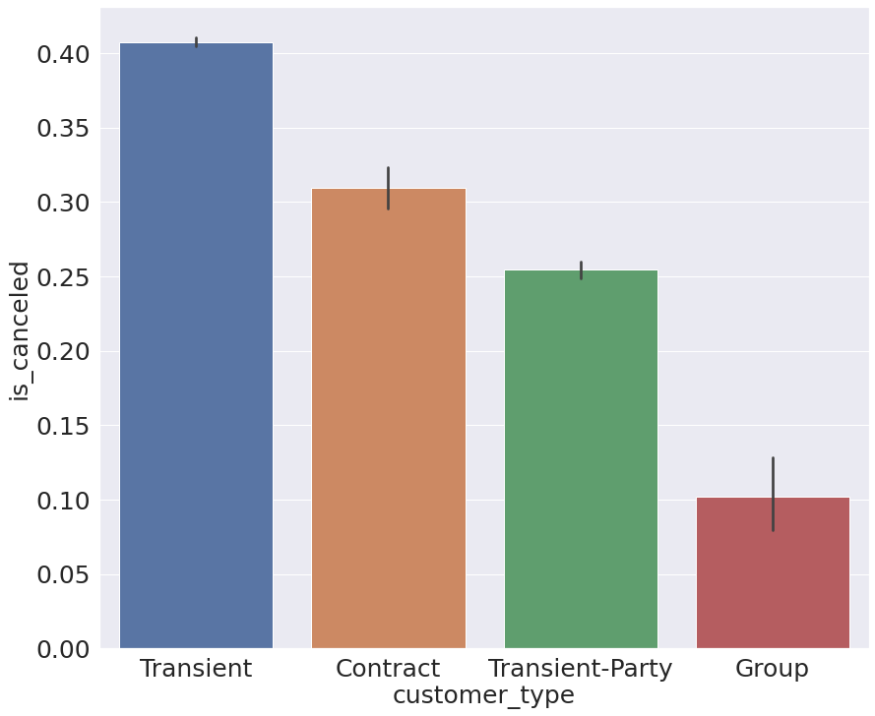
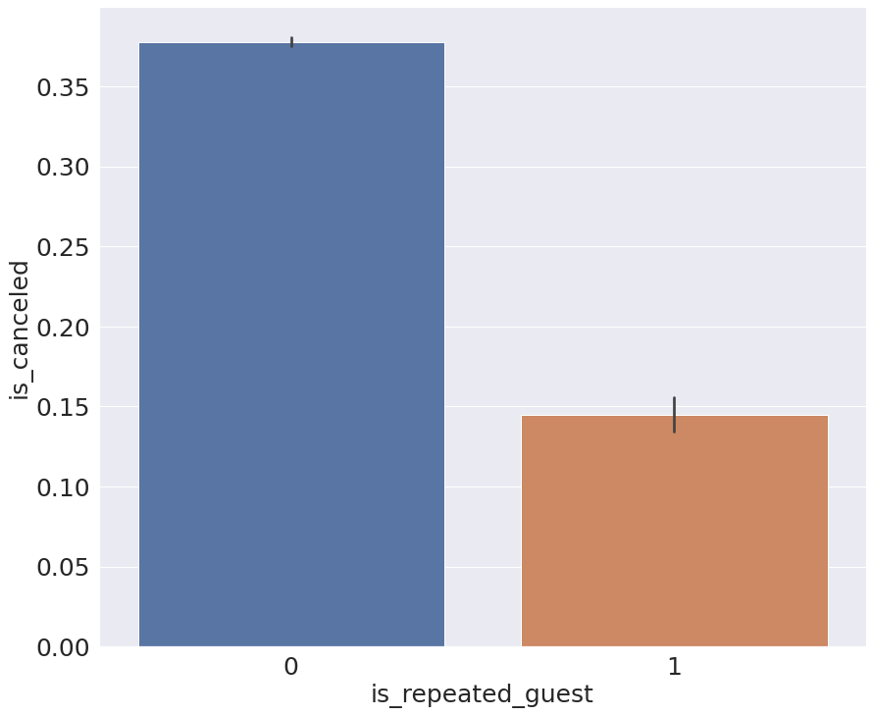
EXPLORATORY DATA ANALYSIS
Iota Integer Team
Customer
Customer Type
Transient type customer (people that book only for short time) are the most likely to cancel, 10 percent higher than the second highest which is contract. Transient customers might have other options for their short stay like staying at a friend, while transient group cannot easily do so. The group in this feature is different than the group in market segment. Here group is interpreted as booking lots of rooms like around 10 rooms for company meetings for example, meaning it is unlikely to be canceled.
Repeated Guest
Not repeated guests tends to cancel their booking which makes sense as it is their first stay and they are not a regular in the particular hotel, so nothing to lose if canceling. While regulars might have a special relationship with the hotel such as points system that they already acquire that can be traded for freebies.
Notes:
Now we look from the customer graph set.
Short stay (transient) customer have a higher chance of cancellation around 0.2 average compared to other types of customer, as they have many option for short stays like staying at a friends rather than staying at hotels while staying for business (contract) or that needs lots of rooms is not as flexible.
Repeated guest that already stayed before actually has a lower chance of cancellation around 0.2, perhaps because they already know and feel comfortable with the hotel from previous stay.

Slide 17
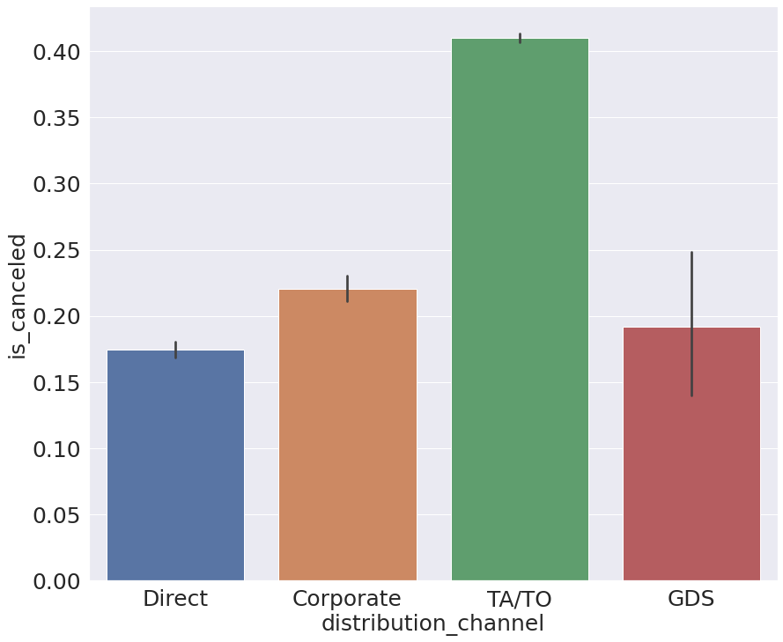
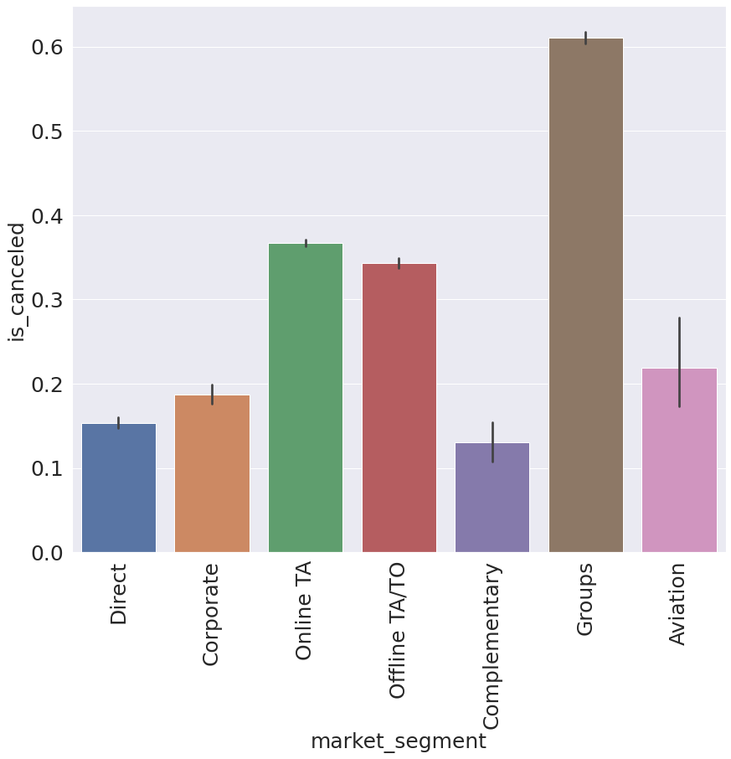
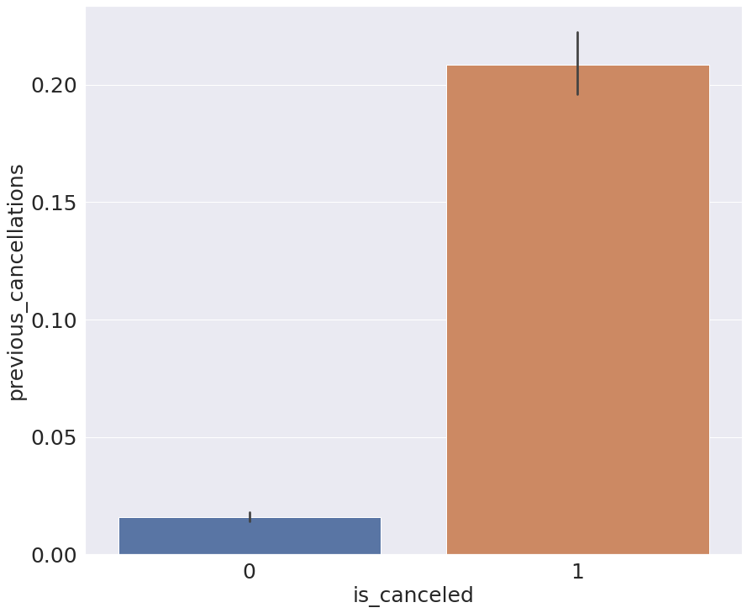
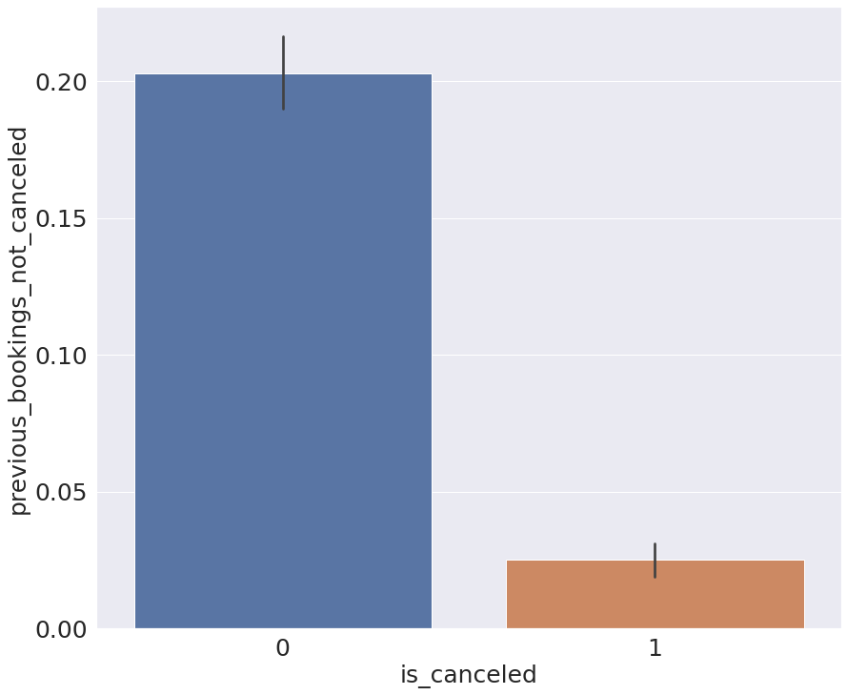
EXPLORATORY DATA ANALYSIS
Iota Integer Team
Customer
Distribution Channel
Customer bookings that was advertised or distributed through travel agent/tour operators tend to be canceled, perhaps because there were changes of plan or it is not in accordance with the customers expectation of visit.
Market segment
Group market segment tends to cancel. The group here is interpreted as customers that just comes together. They tend to cancel probably because in a group if one or two person cannot go, the whole group cancels the booking.
Previous cancelation and not canceled
Customers that already cancel will tend to cancel again. The same tendency for customers that not cancel their previous bookings, it unlikely they will cancel their booking.
Notes:
Still on customer
0.2 higher chance of customer cancels from seeing and making the booking from travel agent/organizer which probably was not in accordance with their plans or expectation.
0.4 higher chance of customers that comes in groups which makes sense as group of people are very dependent of each individuals certainty to show up.
Both cancelling and not cancelling customers has a 0.15 higher chance to do the same thing again.

Slide 18
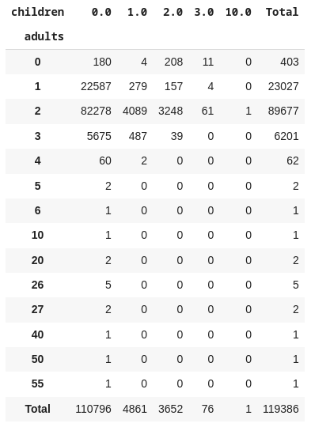
EXPLORATORY DATA ANALYSIS
Iota Integer Team
Table (Customer)
Guests
Here we can see the most bookings was made by 2 adults, followed by 1 adult, group of 3 three adults, and family with 1 to 2 child. We can conclude cancelation occurred mostly from the bookings that were made by adults only without children.
Notes:
Lastly the bookings are made mostly by 2 adults as the booking is highly distributed in that kind of customer.

Slide 19
03
MACHINE LEARNING
Iota Integer Team

Slide 20
STRATEGY
Iota Integer Team
GOALS
Find the highest precision score and stable model
Preprocessing
Modeling
Feature Selection
Feature Engineering
Handling Imbalance
Hyperparameter Tuning
Notes:
The machine learning strategy we set to achieve our goal which is focusing on customer that is cancelling.
To clarify we are focusing only on TP and FP that is:
True Positive which is predicted as cancelled and in reality they actually cancels.
False Positive predicted as cancelled but they actually came which will be a problem for hotels as considered not guaranteeing the booking contract
We consider FN (False Negative) as not a problem when they were predicted as not cancelling but actually did not came which we can just resell the booking on the day for on the spot customers/future customer.
Thus the metric we are going to use will be precision score.
Preprocessing the data consisting of selecting relevant features which are described previously in EDA and engineered them so we are able to enrich and process categorical features.
And then modelling it by comparing multiple models continued by enhancing the performance with handling imbalance and hyperparameter tuning of the selected base model.

Slide 21
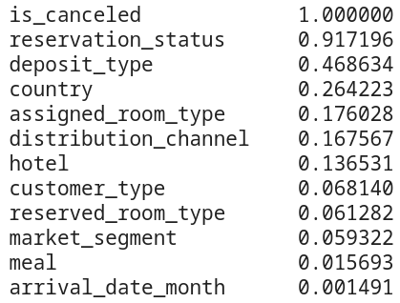
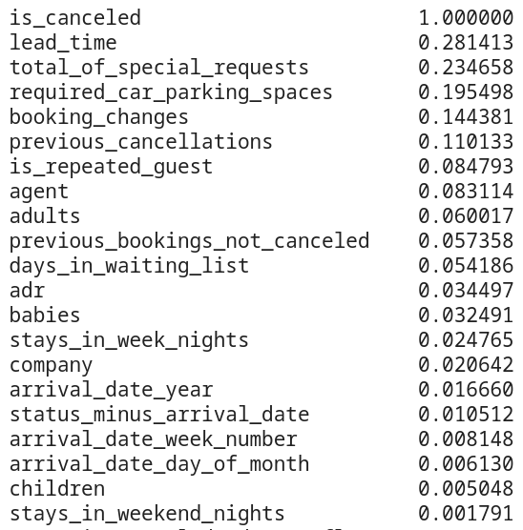
FEATURE SELECTION
Iota Integer Team
Categorical Feature
Numerical Feature
Feature selection with correlation is a quantified approach to help us decide which features are not important and best be dropped.
dropped
no significant effect
Notes:
In the model we dropped the features that we considered as not relevant
Further in the model we found that the highlighted with yellow does not give significant/very low effect to prediction.

Slide 22
FEATURE ENGINEERING
Iota Integer Team
Several treatments:
Remove unnecessary features in modeling to prevent leaking
Encoding categorical data as additional features for modeling
Splitting data between train and test
Target : is_canceled
OneHotEncoder : hotel, meal, distribution_channel, deposit_type, customer_type
BinaryEncoder : country, market_segment, reserved_room_type
Standard scaler : adults
Passthrough : babies, booking_changes, total_of_special_requests
80% as training data
20% as test data
Notes:
The goal from the feature engineering is to make sure that before modeling the data is ready to enrich variables so we can give the most accurate results as possible with this several treatments.

Slide 23
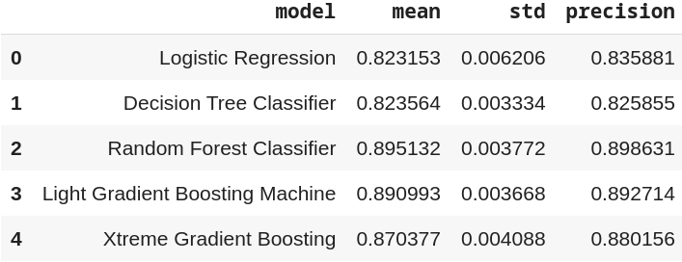
MODELING
Iota Integer Team
Machine Learning Algorithms
Base Model
Logistic Regression
Decision Tree Classifier
Ensemble Model
Random Forest Classifier
Light Gradient Boosting Machine
eXtreme Gradient Boosting
Notes:
We start with applying classification algorithms which is logistic regression, decision tree, random forest classifier, light GBM, and XGBoost.
From the multiple algorithms applied, random forest has higher precision compared to other classification algorithms.
We decide to use random forest classifier as the base model to be used further on.

Slide 24
HANDLING IMBALANCE
Iota Integer Team
The methods for handling imbalance:
Random Under Sampling
Random Over Sampling
Random Forest Classifier Precision Score
model | mean | std | precision
Base | 0.895132 | 0.003772 | 0.898631
Random Under Sampling | 0.902095 | 0.003384 | 0.847828
Random Over Sampling | 0.929119 | 0.002500 | 0.883394
highest precision score
and the most stable
Notes:
With the proportion of data is_cancelled 63:37, it can be stated that the existing data is not balanced, therefore it is necessary to handle imbalance in order to provide an unbiased modelling result.
We use 2 methods to handle the imbalance such as random under sampling and over sampling.
The result for handling imbalance that we’ve got is that the Random Forest strive at oversampling with the highest precision score 89% and the most stable even more stable than random forest classifier in the baseline.
Random Forest with random oversampling will be tuned to get a much more accurate result.

Slide 25
HYPERPARAMETER TUNING
Iota Integer Team
Tuning Random Forest Model
Expected characteristics with a high precision score
Stable value on the base model and during the balancing process
Random Forest Classifier Precision Score
Random Forest Before Tuning | 0.883394
Random Forest After Tuning | 0.912669
Score significant increasing.
Tuned model will be used for prediction
Notes:
We chose Random Forest Model because it has the expected characteristics with a high precision score and has a value that tends to be stable on the base model and during the balancing process. As we can see, after we tune the model, the significant score is increasing so we will use this tuned model for the final model in prediction

Slide 26
04
SOLUTION
Iota Integer Team

Slide 27
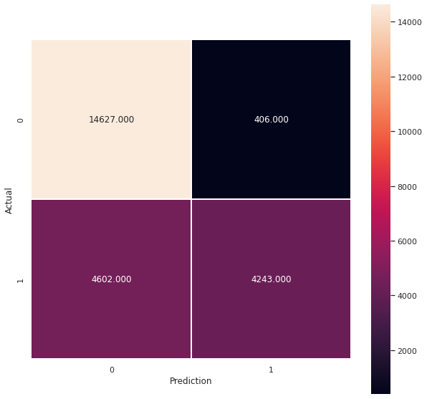
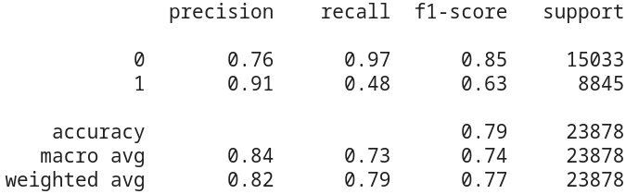
RESULT
Iota Integer Team
TN
FP
Random Forest Precision Score
Base Model | 0.898631
Balanced Model | 0.883394
Balanced & Tuned Model | 0.912669
FN
TP
Notes:
To recap the overall result, we can see that in predicting cancellation the model random forest classifier that is balanced and tuned will be able to have 91% precision score.

Slide 28
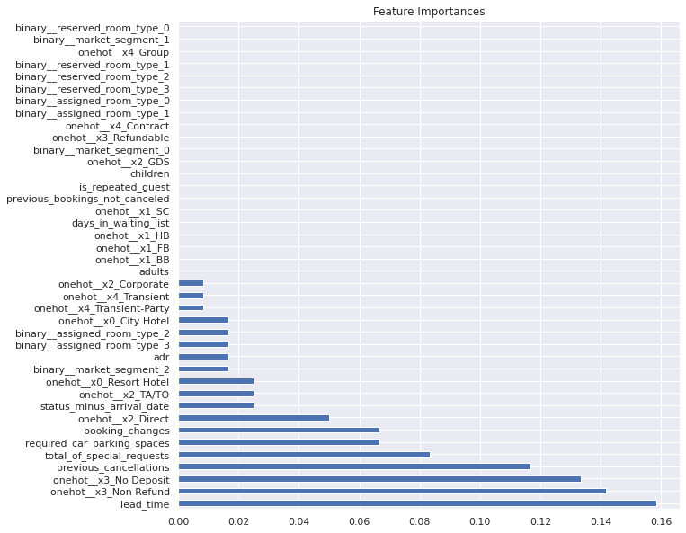
FEATURE IMPORTANCE
Iota Integer Team
Not important:
Meal type
Days in waiting list
Guest
Reserved room type
Assigned room type
Notes:
Feature importance will help us know on what problems we should focus on giving advice to our client.
We can see that deposit type non-refund was the highest feature that is influencing the model and we have 5 features that does not seem to give much influence for the model such as which previously in data analysis we thought would cancel which are meal, days in waiting list, guest, reserved room type, assigned room type
Default choice from meals such as FB and being put longer in waiting list doesn’t seem to influence customers cancelling.
What kind of combination of guest also does not control the people that cancels.
Arrival by month also does not affect cancellations pattern.
Reserved room does not seem to bother which means the assigned room type that is most likely to be more dominant in affecting customer cancellation.

Slide 29
05
RECOMMENDATION & CONCLUSION
Iota Integer Team

Slide 30
CONCLUSION
Iota Integer Team
our model could make hotels avoid a loss of those
customers due to the various reasons of cancelling
by knowing who to prioritize
37%
91%
4m USD
for the next 2 years
prediction success,
the hotel can gain up to
Help the inventory allocation and pricing decision
Notes:
If we try to approach with prediction model and hotels could filter customers that might cancel early on, then our model could make hotels avoid a loss of those 37% customers due to the various reasons of cancelling.
From the price perspective, assuming that from the data which is 100 USD hotel rates which are the ones that are mostly being canceled. With 91% prediction success, the hotel could regain up to 4 million USD for the next same period.
Despite the precision score is already good, additional data that hotel management can try to acquire would always be good to enrich the model and upgrade it periodically to get a much more precise prediction. This will help with inventory allocation and pricing decision.

Slide 31
RECOMMENDATION
Iota Integer Team
Hotel regulations and policies for deposit type should be revised
Promoting saving packages especially in high seasons
A sharing room (bunk beds) as an alternative option especially for transient customers
Early detection system has to be properly managed especially in high season
Offering a form with multiple itinerary choice they can easily pick
Promotion should be direct to give a more personal approach to customers
Notes:
From exploratory data analysis and feature importance in prediction model we can recommend hotels the following to mitigate cancelation:
Most hotels should rework their policies with giving customers refundable option for their booking deposit to avoid customer discomfort in particular hotels, they can also give flexible terms for high price booking considered as partial refundable scheme which avoid customer confusion and loss revenue.
City hotels can try to keep up with competitors with promoting saving packages especially in high seasons. If the price cannot be cut significantly for the promo then giving additional services like free one day spa or free ticket to local attraction.
Assigning a sharing room scheme can be much more cheaper for short staying customer and would likely retain their booking.
Early detection system to prioritize people that will actually came to guarantee their booking which are with shorter lead time, positive historical tendency, and regular/loyal customers.
Mitigating the high chance of a customer changing plans perhaps can be dealt with offering a form with multiple itinerary choice they can easily pick, alongside with special requests that a customer can have with no extra charge. Giving awareness to customer of such service is a good complimentary. Coupling promo with this service will really improve customer comfort.
Promotion should be direct to give a more personal approach to customers to increase their convenience. This can be coupled with probably a points system that also increases chance of customer loyalty and makes them a regular guest at the hotel especially for the transient type customers and groups.

Slide 32
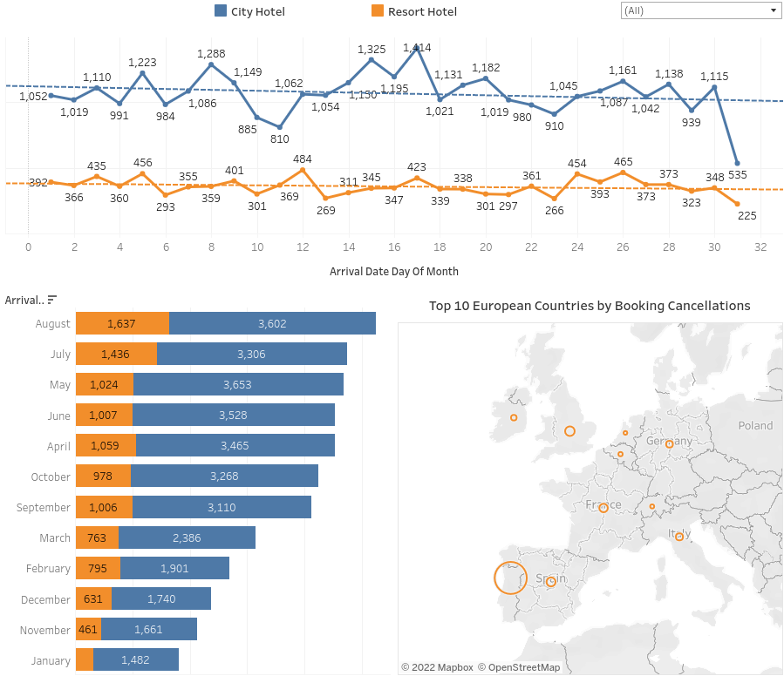
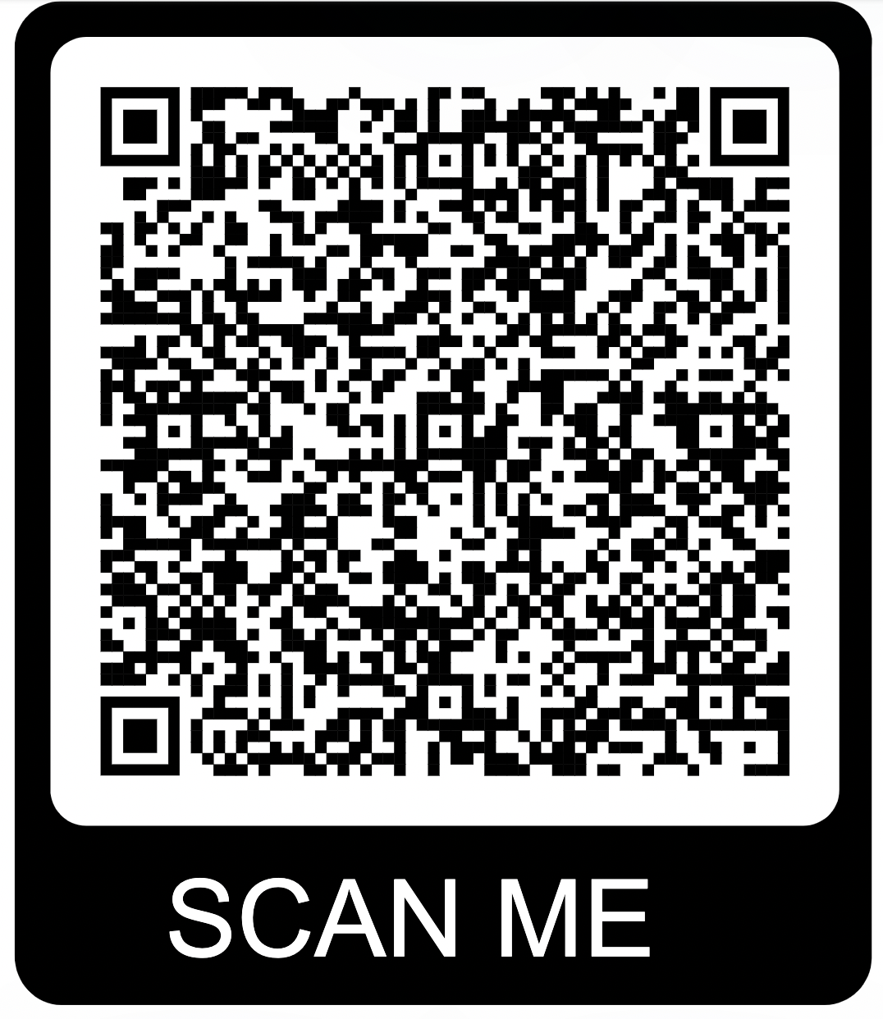
TABLEAU DASHBOARD
Iota Integer Team
https://public.tableau.com/views/hotel_bookings_16580755476150/Dashboard?:language=en-US&:display_count=n&:origin=viz_share_link
Notes:
This the dashboard that we provide for the hotel management to monitor their data

Slide 33
Thank You
Notes:
Any questions?

